Slide 1
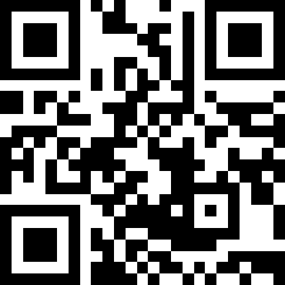
Open Forum (5:00-5:30)
Enjoy Some Food!
Sign-in Link:
https://tinyurl.com/GPSS23SignIn
Slides Link:
https://tinyurl.com/GPSS23SignIn

Slide 2
GPSS Orientation
24th August, 2023
https://tinyurl.com/GPSS23SignIn

Slide 3
Senator Sign-in/Dept. Check-In
https://tinyurl.com/GPSS23SignIn

Slide 4
Orientation
What is Shared Governance?
What is GPSS?
What Events do we do?
Who are Senators?
What are commissions, task forces and committees?
What are internal committees?
What is a resolution and how do they work?
How can I write a resolution?
What are Robert’s Rules?
How do meetings work?
This portion of the meeting will be recorded so people can revisit this information later.

Slide 5
Shared Governance Overview:
How we interact with each other and admin to make change at the University.
Central Body is University Council (UC), which has many Commissions and Committees
Also under UC are the Senates
Staff Senate
Faculty Senate
A/P Faculty Senate
Undergraduate Student Senate
Graduate and Professional Student Senate
Notes:
The structure in which that the multitude of constituencies and groups at VT interact with each other and admin to make change at the University.

Slide 6
About GPSS
What we do?
We serve as a voice for all graduate students
How we do it:
Bring together representatives from all departments
Identify common issues and concerns → work towards solutions
Sit on university commissions & committees to represent grad students
Write and pass resolutions as new University Policy
Host events and programs for academic and social support
Notes:
through both advocacy to the University as a whole and community-building for all our constituents.

Slide 7
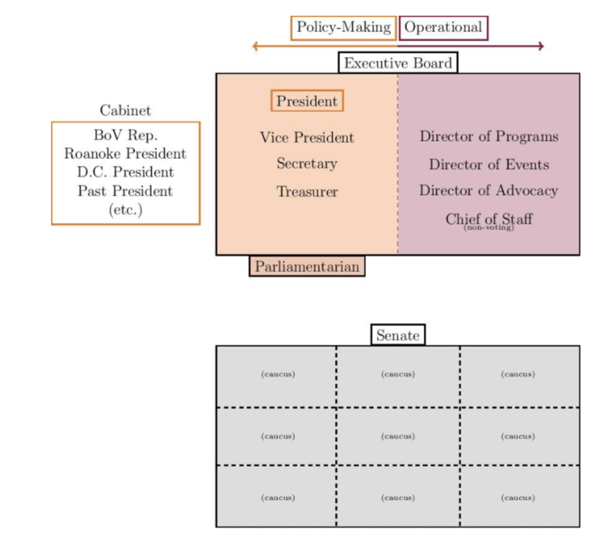
GPSS Structure
2 Senators from every department
Elected Executive Board
Cabinet of all grad leaders
Director of Finance
Director of
Communications

Slide 8
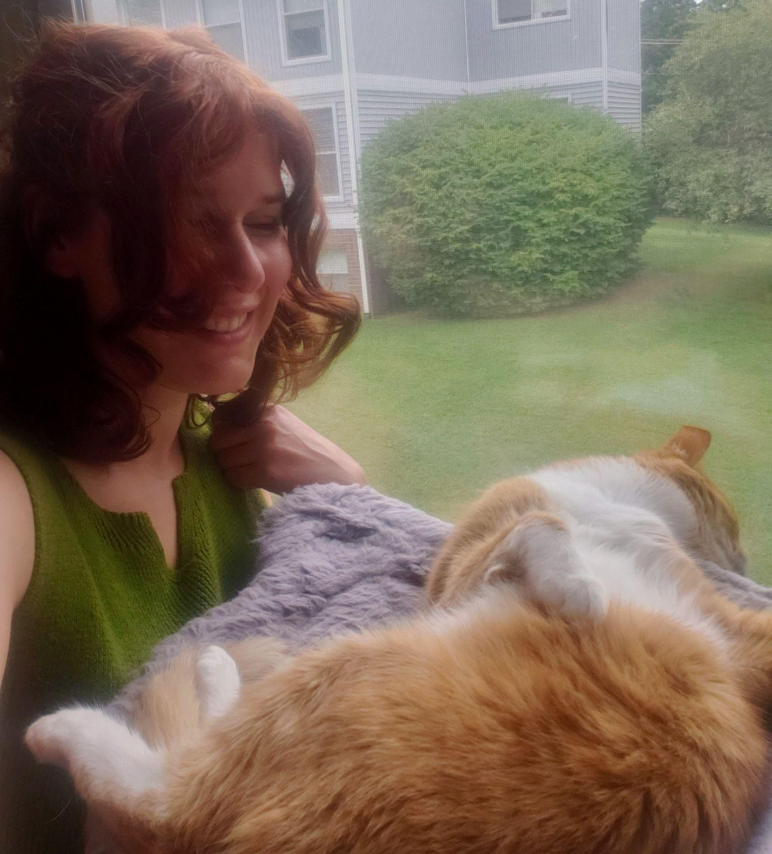
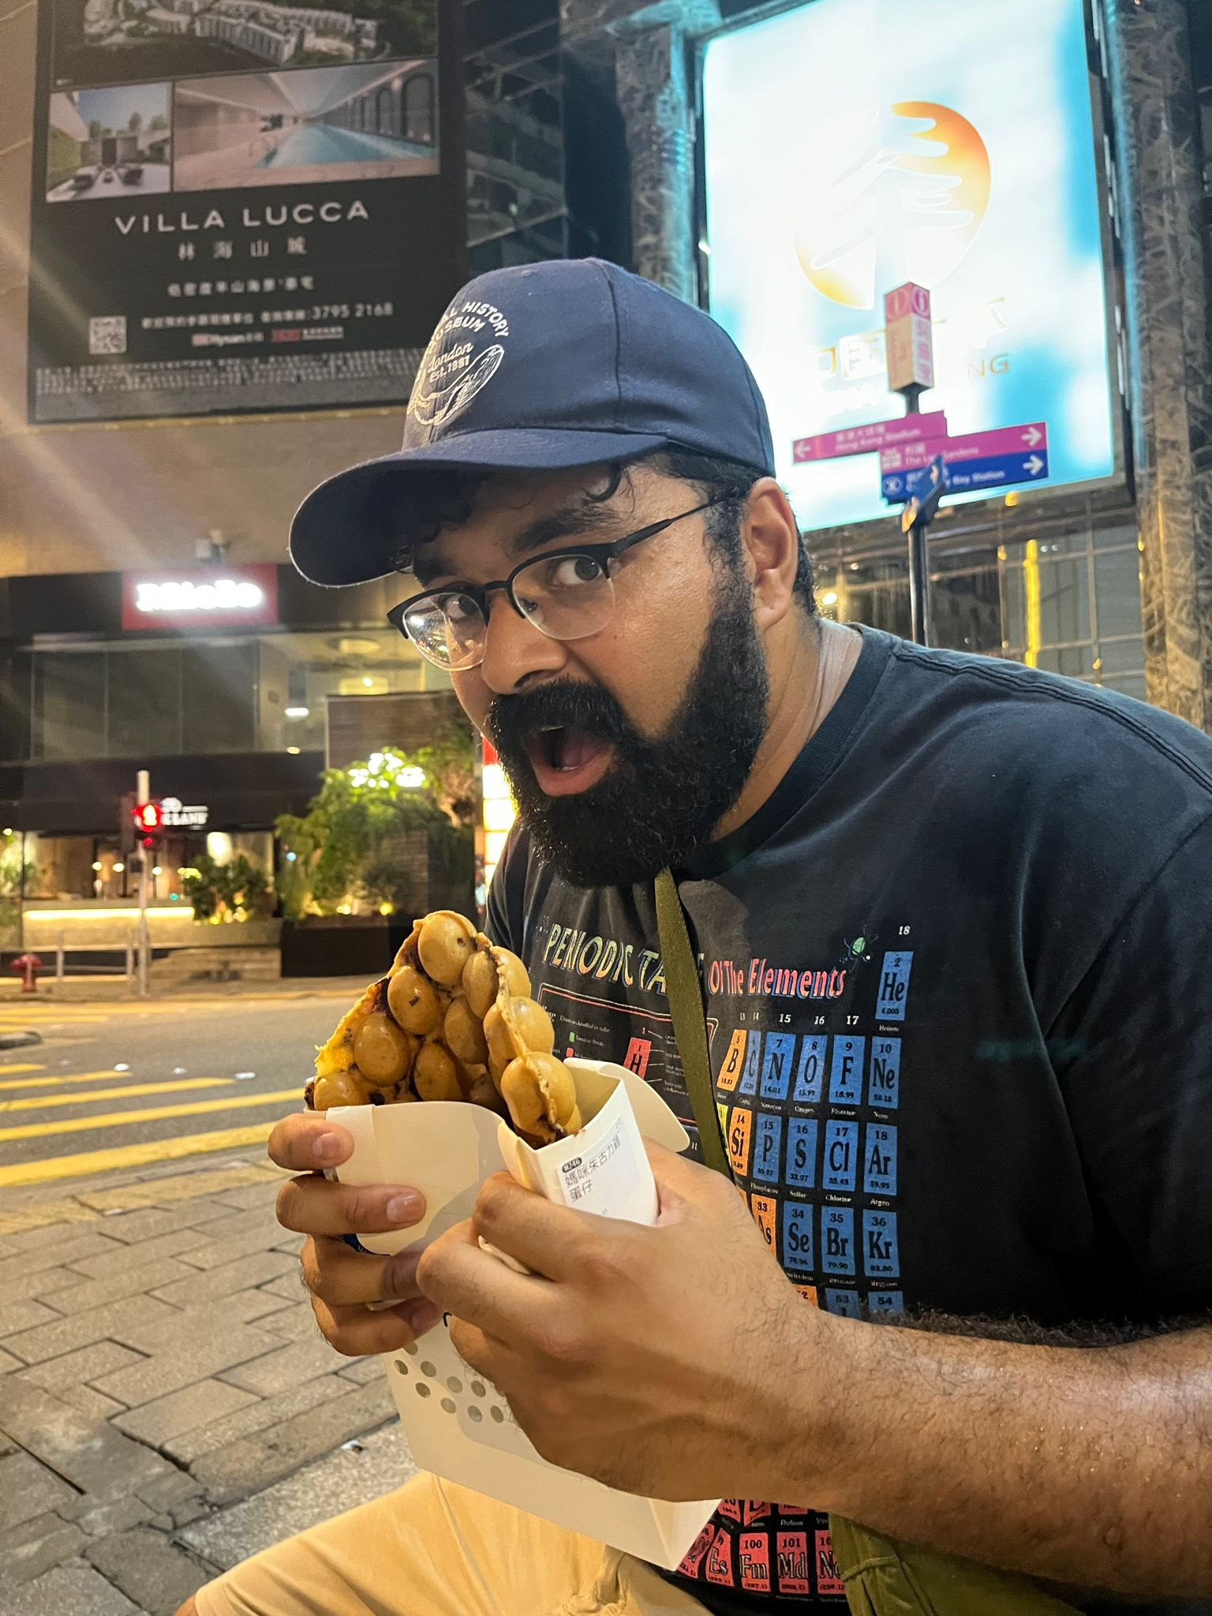
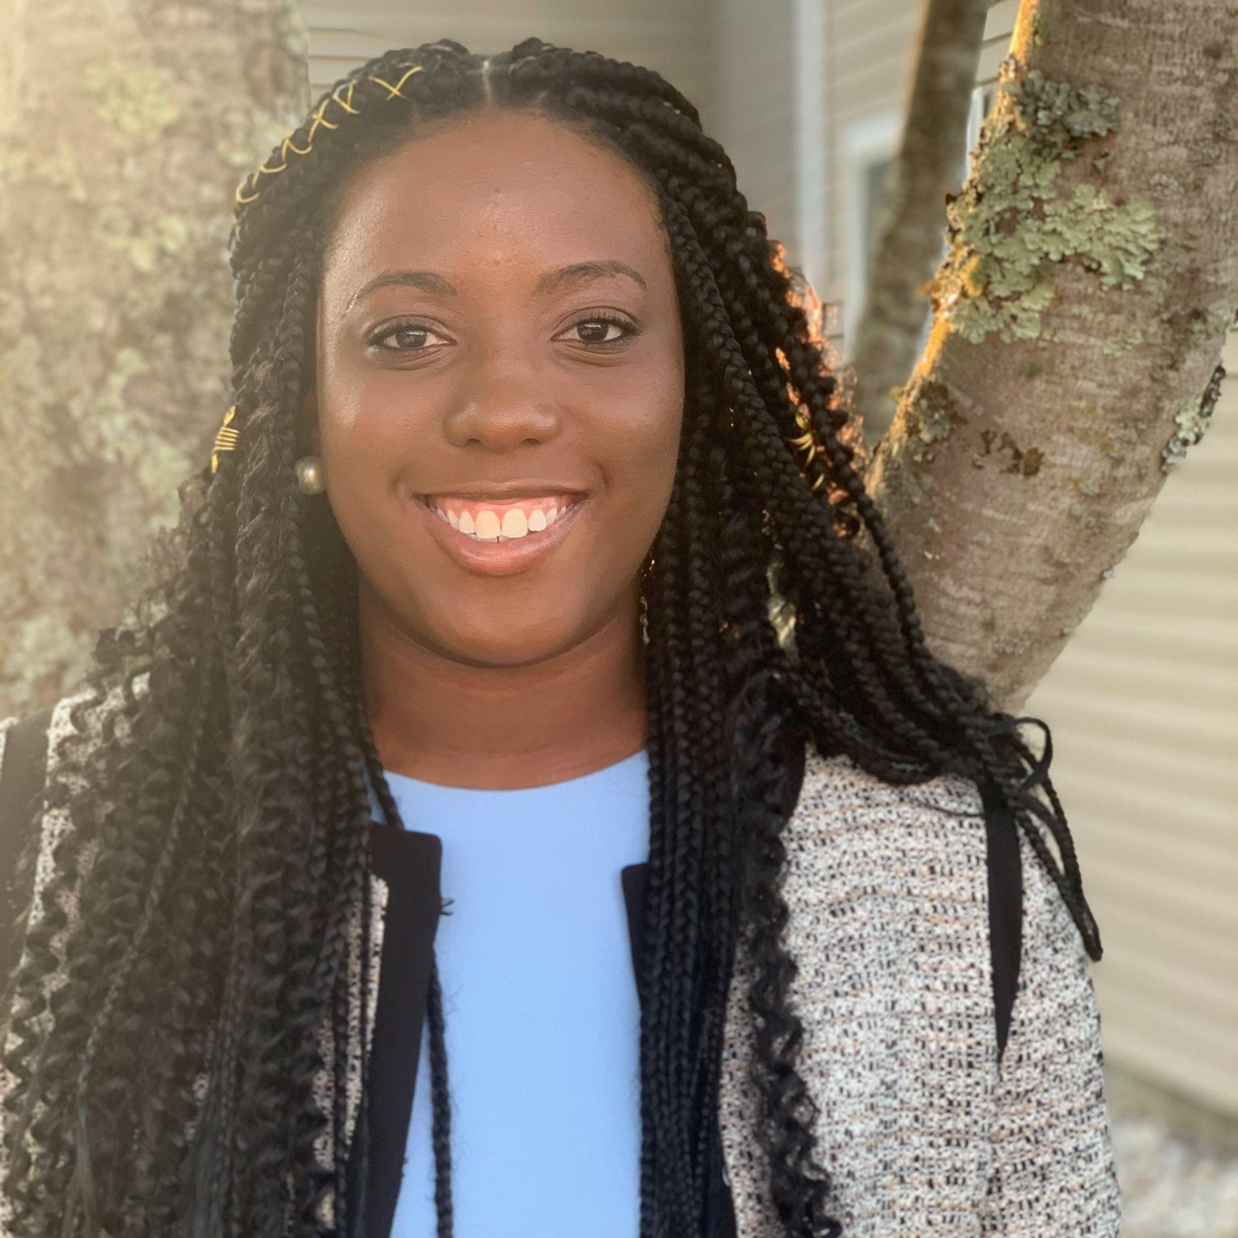
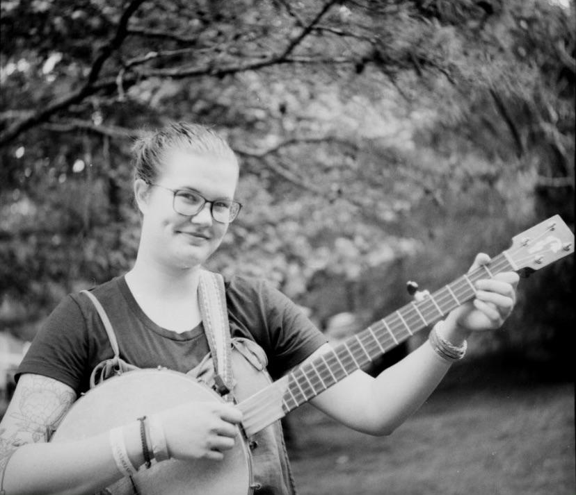
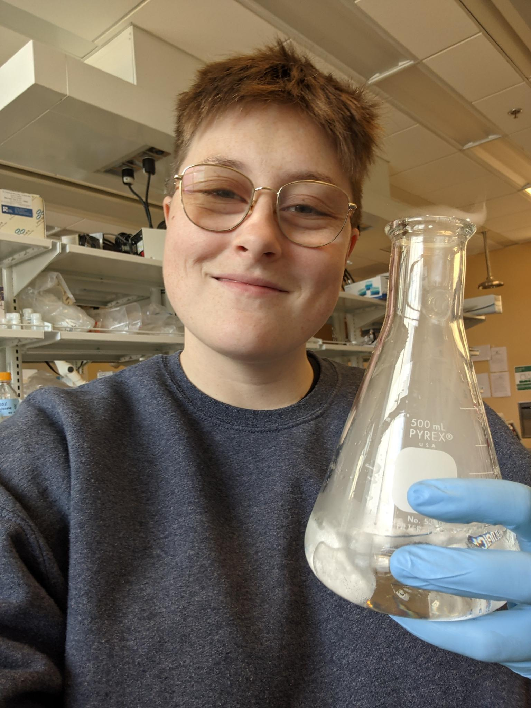
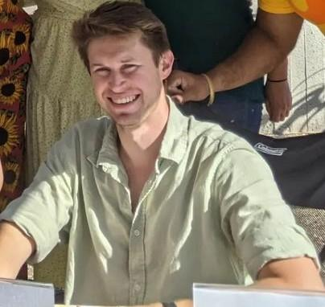
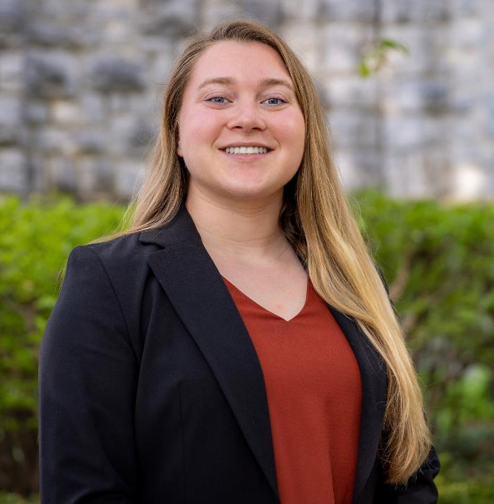
Meet the Executive Board 23-24
President:
Rachel Maizel
Vice President:
Yohan Sequeira
Director of Finance:
Quiyana Murphy
Director of Programs:
Aran Garnett-Deakin
Director of Events:
Isaac Pressgrove
Director of Comms:
Riley DeHority
Director of Advocacy:
Pending Election!
BoV Rep:
Emily Tirrell

Slide 9
Senator Responsibilities
Attend all Senate meetings (or send a proxy if unavailable)
Communicate with their constituents to:
Solicit input on current issues
Keep apprised of senate ongoings and important initiatives
Participate in at least one internal or external committee/commission

Slide 10
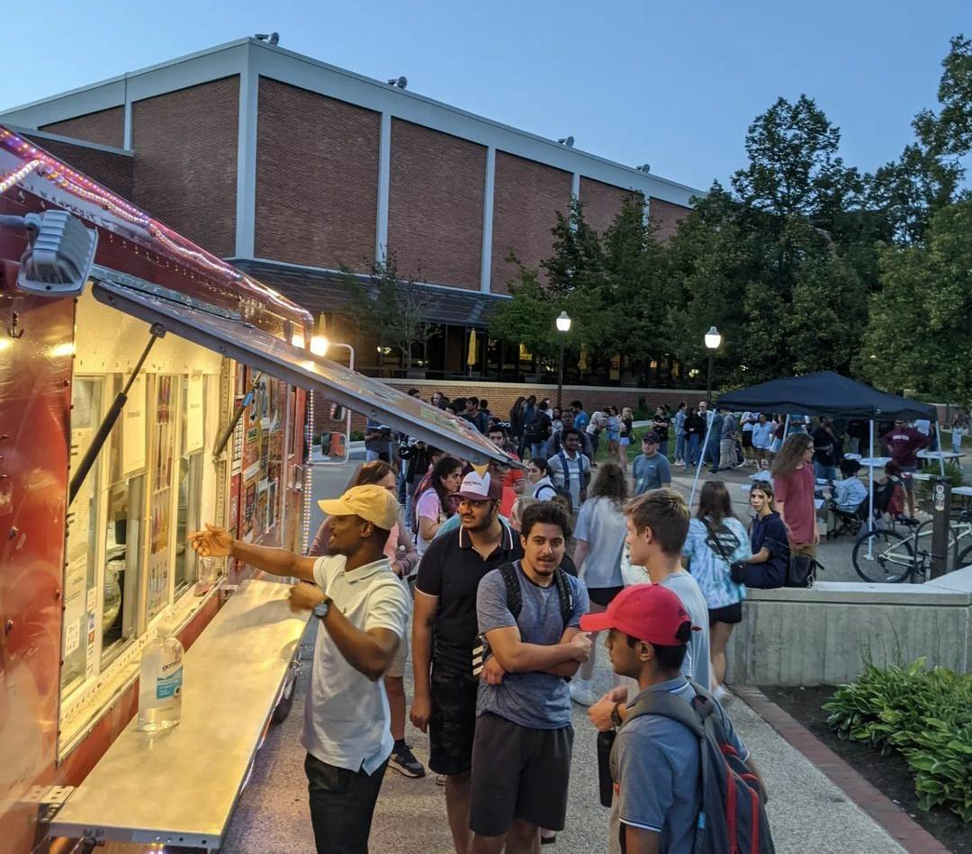
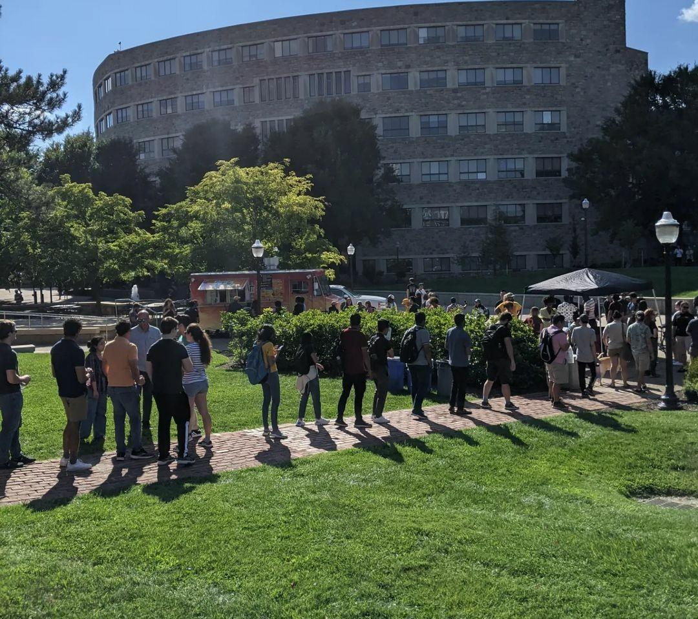
Events
Welcome Back BBQ
Regular Senate Brewery Gatherings
Meet The Dean Events
Little Hokie Hand Me Down
Graduate and Professional School Fair
Other Fall Socials
Notes:
Come meet the exec board and senators every other friday night at a local Brewry!
: Donuts with the Dean, Taco Talk, and Decorating cookies to meet Aimee Surprenant, the Dean of the Graduate School!
: Free hand-me-down clothes for university students and staff members with children.

Slide 11
Programs
Travel Fund Program → Funding for conference presentations (most popular)
Cap & Gown Loan Program → PhD and master’s robes
Graduate Research Development Program (GRDP) → Student-run, merit-based research grants
Graduate Research Symposium → Present your research to interdisciplinary audience. Prize money available

Slide 12
University Commissions
Commissions are UC entities with specific domains.
Their membership are representatives from all the Senates and pertinent admin.
University Commissions:
Commission on Outreach and International Affairs
Commission on Equal Opportunity and Diversity
Senate Commissions:
Commission on Faculty Affairs
Commission on Research
Commission on Administrative and Professional Faculty Affairs
Commission on Staff Policies and Affairs
Commission on Graduate and Professional Studies and Policies
Commission on Graduate and Professional Student Affairs
Commission on Undergraduate Studies and Policies
Commission on Undergraduate Student Affairs

Slide 13
Commission on Graduate and Professional Student Affairs (CGPSA)
23-24 Chair: Ranald Adams
“Charged to study, formulate, and recommend the GPSS policies and procedures concerning grad and professional student life and morale.”
Senator Membership: 9 graduate students elected by GPSS (one per college)

Slide 14
External Committees
Committees are basically the same as Commissions, just smaller in scope, make recommendations:
Climate Action, Sustainability, and Energy Committee
Information Technology Services and Systems Committee
Athletics Committee
Transportation and Parking Committee
Commencement Committee
Employee Benefits Committee
Graduate Curriculum Committee
Library Committee
Intellectual Property Committee
Budgeting and Planning Committee
Campus Development Committee

Slide 15
Ad Hoc: Task Forces, Working Groups
Task Forces are temporary groups formed to address specific issues:
Stipend Taskforce
Housing Taskforce
Working Groups are similar, but longer-term:
Campus Accessibility Working Group
Personal Transportation Devices Working Group

Slide 16
Internal Committees
Committees to conduct the daily workings of GPSS. Each is run by an exec board member
Graduate Student Budget Board (GSBB, chaired by Director of Finance)
Committee on Judicial and Internal Affairs (assists the President and VP)
Programs Committee (Assists the Director of Programs)
Events Committee (Assists the Director of Events)
Communication Committee (Assists the Director of Communications)
Advocacy Committee (Assists the Director of Advocacy)
Possibility for more, temporary committees as needed. More information on these roles in Section 3 of the GPSS Bylaws.

Slide 17
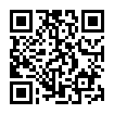
Graduate Student Budget Board (GSBB)
The GSBB manages the allocation process of the funds appropriated to graduate and professional student organizations from student activity fees.
Handle ~$100k+ available for graduate student organizations (RSOs) to use for events!
Interested in serving on this committee. See me at the end of the meeting or QR Code:.

Slide 18
Graduate Student Budget Board (GSBB)
Voting members (11), at least one Senator from each college. One member chosen as Vice-Chair.
College of Agriculture and Life Sciences (CALS)
College of Natural Resources and Environment (CNRE)
Pamplin College of Business
College of Literature and Human Studies (CLAHS)
College of Engineering (COE)
College of Architecture and Urban Studies (CAUS)
College of Science (COS)
Extended Campus
Notes:
This Committee is very important. Without members on this committee we can’t fund Programs for Graduate Student Organizations. We still need 9 members.

Slide 19
What Is A Resolution
Resolutions are proposals & policies recommendations that impact the university.
Resolutions can be written & submitted by anyone.
Resolutions are to be discussed & approved, first by the appropriate Senate, then by the University Council, and lastly by the President and, if applicable, Board of Visitors to be enacted in effect.
GPSS + CGPSA
UC
President & BoV
🎉
Resolution F: $15 Min. Wage for Employees
Resolution B: Contract Extension from 9 month - 12 month
Resolution J: Expand Protections for International Students
Notes:
Based on latest constitution
Resolution example comes from: https://docs.google.com/document/d/1fJOrYn1lHPIX-Izrx3juT7LikbKqzqH3jRRpEIq8xN4/edit

Slide 20
How to Write a Resolution
A Resolution consist of:
Header,
Approvals,
WHEREAS Statements,
THEREFORE, BE IT RESOLVED Statements,
Policy Reference.
WHEREAS Statements describes the 1) context of the issue, 2) bodies involved, 3) nature of the problem and solutions
Consult Budget Office, Legal Counsel, Human Resources
Notes:
https://governance.vt.edu/resolutions.php (a php website…x_x)

Slide 21
Initiatives and Resolutions for this year
Initiatives: Holistic approach to data collection & policy regarding:
Analyzing Stipend 5% Increases Over Past Several Years
Living Wage Task Force Implementation
Comprehensive Fee Reduction/Waiver
Housing Study Continued
Department Climate and Culture Study
Climate, Culture, and Academic Harm Prevention
Refining Graduate Assistantship Contract Guidelines and Protections
Accountability for Student Organizations Misbehavior
Special Emergency Funds to Escape Toxic Advisor
Parking
Food Security

Slide 22
Robert’s Rules
Rules of Procedure that governance operates on:
Quorum
Actions of the Senate done through Motions (First, Second, Discuss, Approve)
Approving agenda
Amendments
Adjourning
Votes to Approve
All Resolutions get First and Second Readings

Slide 23
General Meeting Plan
Open Forum when we can discuss anything
Quorum and Opening Remarks
Present Agenda
Updates from Exec Board, BOV Rep, and Internal Committees
Updates from Commissions, External Committees
Updates from Ad hoc groups (working groups, taskforces, etc.)
Unfinished Business
New Business
Closing Remarks
Senate Brief sent out after every meeting.

Slide 24
End of Orientation, Questions?

Slide 25
Senate Meeting
24th August, 2023
Slides Link:
https://tinyurl.com/GPSS23SignIn

Slide 26
Meeting Agenda
Opening remarks & senator sign-in
Exec Board Reports
Commission and Committee Reports: Open remarks
Ad hoc reports: Housing
Unfinished business: None
New business: Bylaws, Advocacy Elections/Election Czar
Closing remarks: Reminders, Communication, Events!

Slide 27
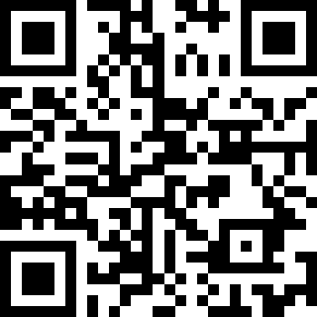
0. Vote To Amend Agenda
Amend Agenda: add approval of Advocacy Elections/Election Czar to New Business.
https://tinyurl.com/GPSSAgendaVote824

Slide 28
Meeting Agenda
Opening remarks & senator sign-in
Exec Board Reports
Commission and Committee Reports: Open remarks
Ad hoc reports: Housing
Unfinished business: None
New business: Bylaws, Advocacy Elections/Election Czar
Closing remarks: Reminders, Communication, Events!

Slide 29
Opening Remarks
Welcome to the first GPSS meeting of 2023! Sign-in if you have not!
If you have not registered as a Senator yet (haven’t received the info emails this week) please email VP Yohan Sequeira (yohans21@vt.edu) to be added to the roles!
https://tinyurl.com/GPSS23SignIn
Notes:
yohan

Slide 30
Notes on Zoom and In-Person
Voting: Only senators and designated proxies may vote. Vote using yes (green checkmark), no (red X), and abstain (coffee cup away) emotes.
Speaking: Everyone will be muted and you will have to use the raise hand feature to unmute yourself. Priority will be given to senators over general graduate students.
In-Person: Please raise your hand with a thumbs-up for yes, thumbs-down for no and don’t raise your hand to abstain.
Please RESET your emote after voting or raising your hand. We cannot distinguish between leftover emotes and current emotes so it is on you to remember to remove your answer after the vote concludes. If you do not lower your hand we may not call on you.
The most important rule is that you MUST show off your pets and tell them they’re very good courtesy of the GPSS.

Slide 31
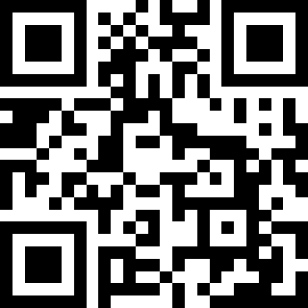
Vice President: Committees & Senators
SIGN UP FOR COMMITTEES:
Please sign up by AUGUST 31st!
https://tinyurl.com/GPSS23Signup

Slide 32
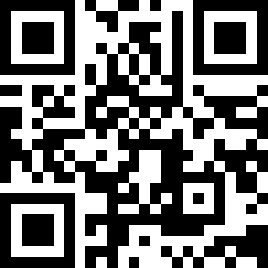
New Ad-Hoc Committees: Climate & Culture
Establishing a new Ad-Hoc Committee to:
Determine 4 departments to perform climate & culture survey in
Help advertise climate & culture survey
Analyze the results and make an executive summary
Need 2-4 volunteers
Sign-up here
https://tinyurl.com/GPSS23Signup

Slide 33
New Ad-Hoc Committees: Stipend Analysis
Establishing a new Ad Hoc Committee to:
Sort through our survey data analyze who:
did not get 5% increase
is not at their college’s promised minimum
received less overall with increase in fees
Sift through graduate school data of past few years on 5% increases to see who missed 5% increases and were never compensated
Need a few volunteers
Email Rachel at maizer@vt.edu if interested

Slide 34
New Ad-Hoc Committees: Housing Analysis
Establishing a new Ad Hoc Committee to sift through and analyze housing survey data (experience with data analysis and statistics is a plus)
Need 1-2 volunteers
If interested email Yohan at yohans21@vt.edu

Slide 35
Director of Finance
My Role:
Serve as Chair of the GSBB (discussed earlier)
GPSS Finances and Budget
Representative for the Student Activities Fee Allocation Board (SAFAB)

Slide 36
Director of Finance: Report
GPSS Budget, Beginning of the year:
Budget Board Allotment: $24,438
Generated Funds: $71, 265.95
Spent so far: ~6,000
GSBB:
Total Budget: $100,000
Allocated: ~10,000

Slide 37
Director of Programs
SIGN UP FOR PROGRAMS COMMITTEE - needs committee members ASAP to deal with funding program applications.
GRDP: Need two more reviewers to wrap up Fall GRDP. Please email acgarnet@vt.edu if you’re interested in helping.
Graduate Research Symposium Co-Chair: Applications are due September 1st.

Slide 38
Director of Events
Upcoming Events:
GPSF Happening October 2nd
General Social, Happening Sometime in mid to late September
Tacos with the Dean, TBD
Many apologies for the long line at the BBQ, we will know better for next time!

Slide 39
Director of Communications
BOV Meetings are Sunday-Tuesday
Follow @VTGPSS
Join my committee, it’s going to be fun!

Slide 40
New Business: Edits to Bylaws
Proposing new edits to bylaws with further clarification of
Standing Committees
Senator Responsibilities
Executive Board Member Expectations
Please add all comments by (8/31):
https://docs.google.com/document/d/1o_6VlY8Fa68F9do05ayq8B8T5CS58I08B7dNq_GPNC8/edit?usp=sharing

Slide 41
New Business: Elections for Director of Advocacy
We need an elections Czar to handle the election (mainly the application process and counting of votes).
Any Volunteers? (we would like to get the process going ASAP)

Slide 42
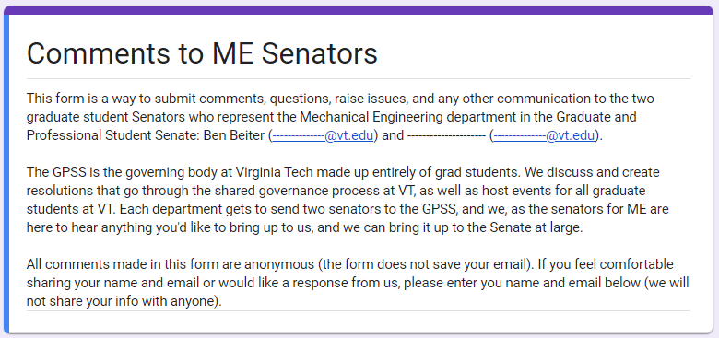
Closing Remarks: Communication
All Senators are expected to communicate with your constituents.
Send out Senate Brief to everyone
Anonymous Feedback Form
Notes:
Feedback about Senate meetings or resolutions

Slide 43
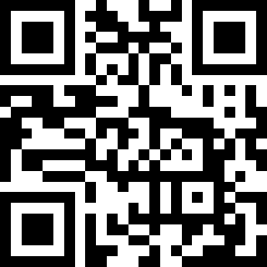
Closing Remarks:
Are you involved in sustainability research or educated or interested in becoming involved? Please take the following survey:
https://virginiatech.questionpro.com/CALL2023-2024
To get resources and share expertise.

Slide 44
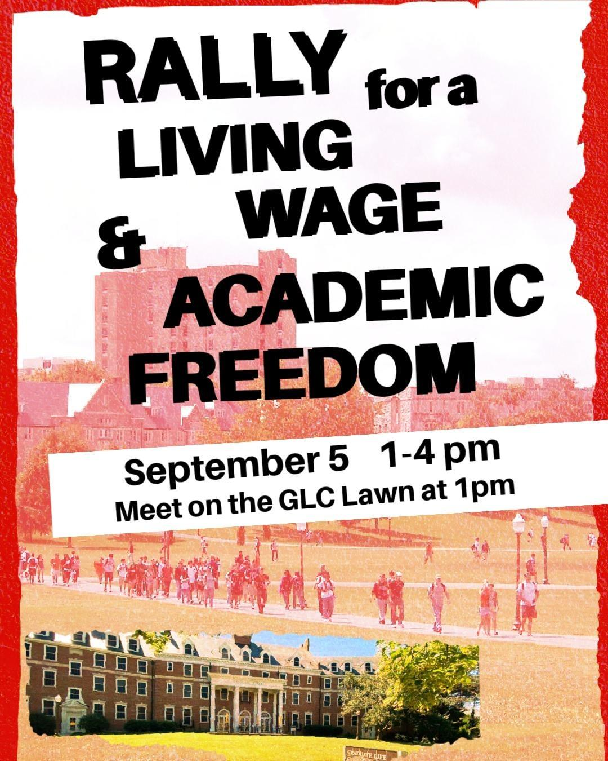
Closing Remarks:
Are you passionate about getting paid a living wage?

Slide 45
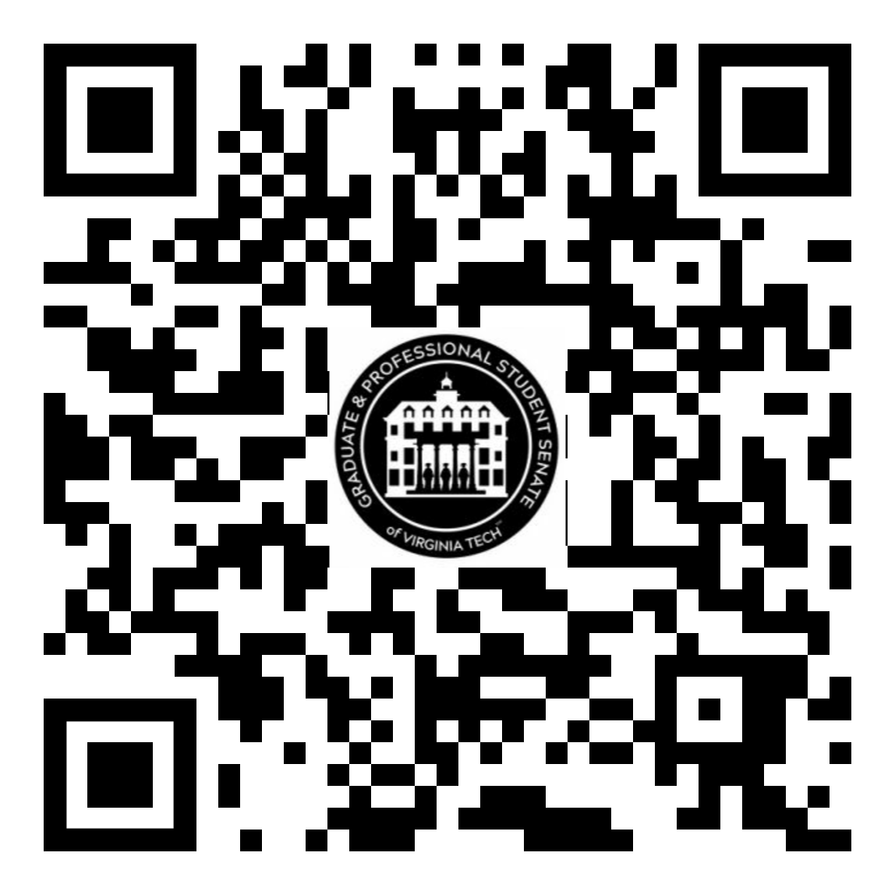
Conclusion
Senate Discord:
Motion to Adjourn!
Follow us on Instagram and Twitter:
@vtgpss
Public GPSS Discord for all grad students:
tinyurl.com/GPSS22GradDiscord

