Slide 1
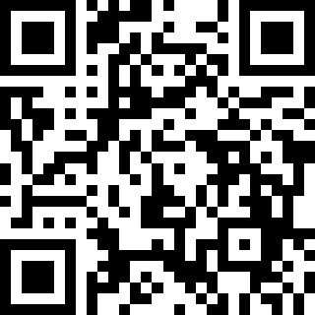
Open Forum (5:00-5:30)
Enjoy Some Food!
Sign-in Link:
https://tinyurl.com/GPSS090723SignIn
Slides Link:
https://tinyurl.com/GPSS090723SignIn

Slide 2
Senate Meeting
7th September, 2023
Slides Link:
https://tinyurl.com/GPSS090723SignIn

Slide 3
Meeting Agenda
Opening remarks & senator sign-in
Reports:
Exec Board Updates
Other updates
General Orders:
Director of Advocacy Elections Announcements
Unfinished Business: None
New business:
Commissions and Committee Appointments and Parliamentarian
Comments on Bylaws Resolution 1st Reading
Comments on VT GLU Statement of Support
Closing remarks: Reminders, Communication, Events!
Notes:
ask for a motion to approve the agenda, (do i have a motion to approve the agenda?, do i hear a second? all those in favor? thumbs up or green check mark

Slide 4
Opening Remarks
Sign-in if you have not! https://tinyurl.com/GPSS090723SignIn
If you have not registered as an Senator yet (haven’t received the info emails this week) please email VP Yohan Sequeira (yohans21@vt.edu) to be added to the roles!

Slide 5
Notes on Zoom and In-Person
Voting: Only senators and designated proxies may vote. Vote using yes (green checkmark), no (red X), and abstain (coffee cup away) emotes.
Speaking: Everyone will be muted and you will have to use the raise hand feature to unmute yourself. Priority will be given to senators over general graduate students.
In-Person: Please raise your hand with a thumbs-up for yes, thumbs-down for no and don’t raise your hand to abstain.
Please RESET your emote after voting or raising your hand. We cannot distinguish between leftover emotes and current emotes so it is on you to remember to remove your answer after the vote concludes. If you do not lower your hand we may not call on you.
The most important rule is that you MUST show off your pets and tell them they’re very good courtesy of the GPSS.

Slide 6
Approval of Minutes
Minutes were sent out last week with the Brief, and can be found in your inbox

Slide 7
IMPORTANT MESSAGE

Slide 8
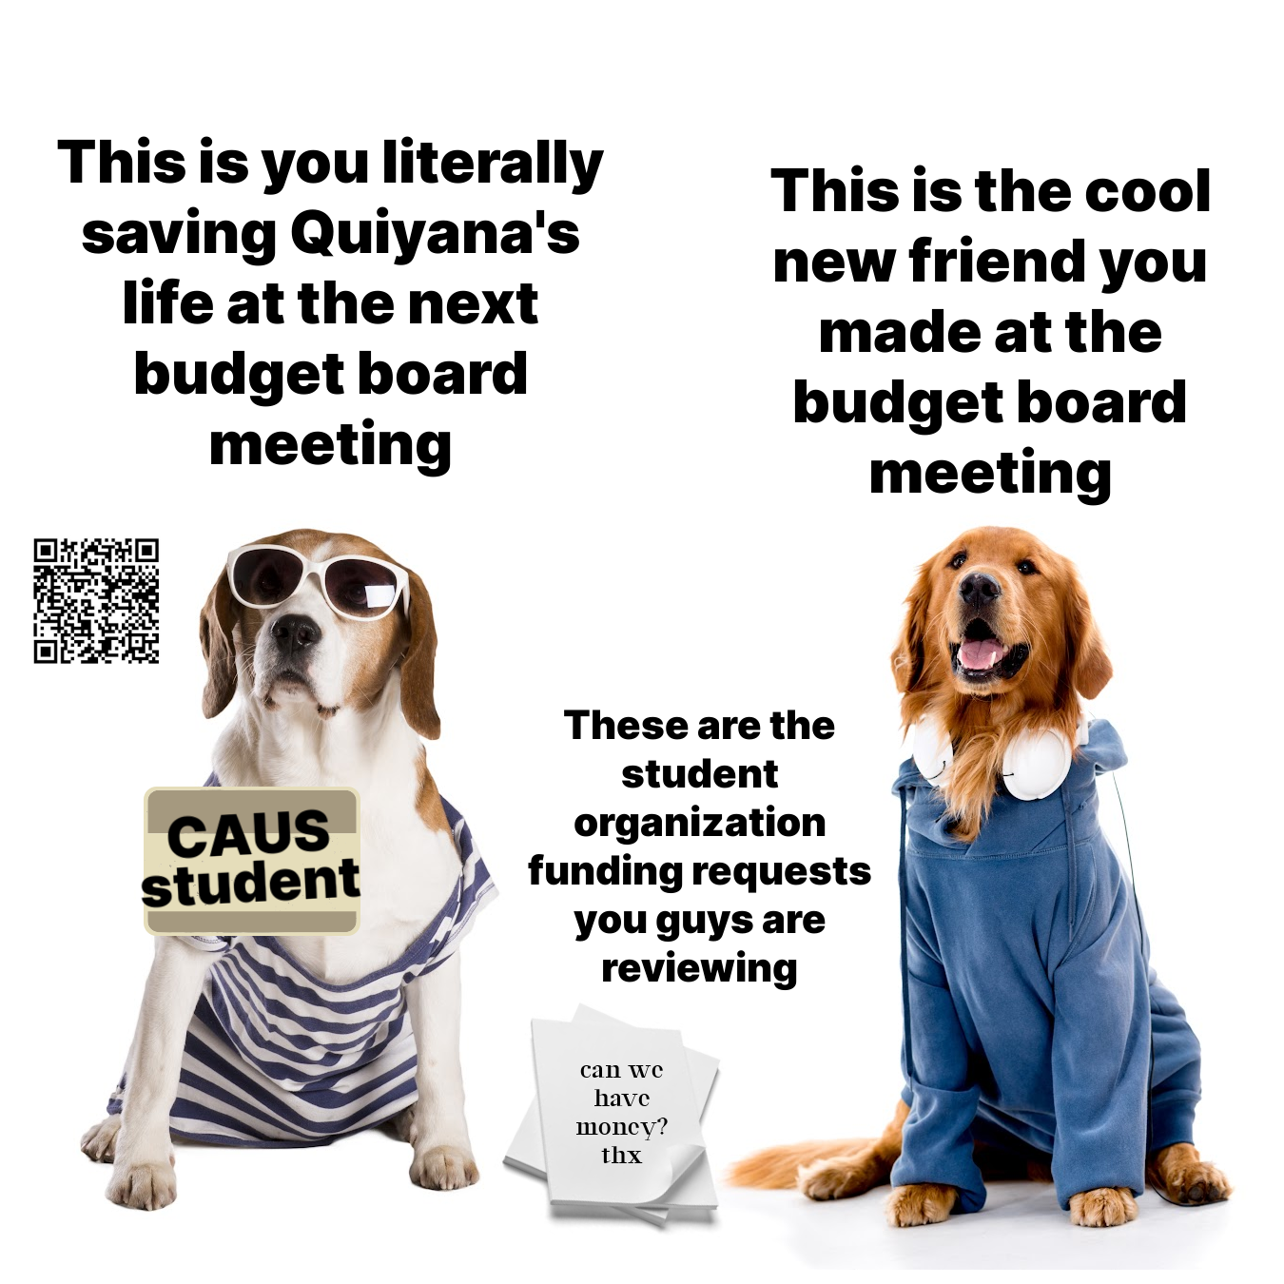
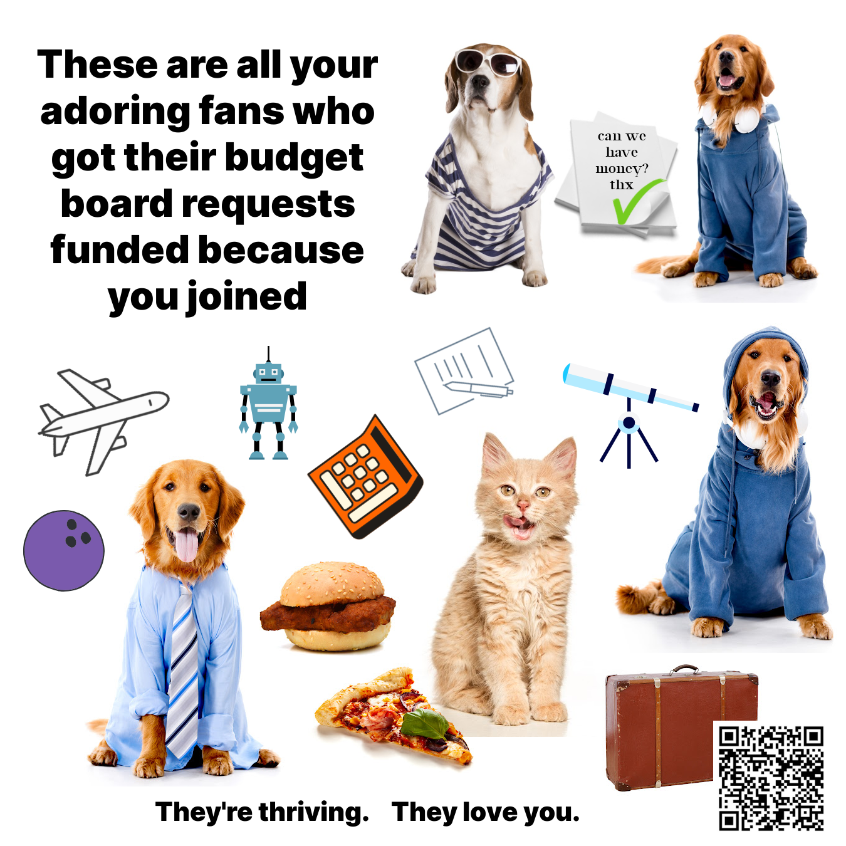
IMPORTANT MESSAGE

Slide 9
IMPORTANT MESSAGE

Slide 10
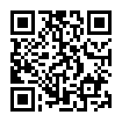
2. Exec Reports: Internal Committee Sign-ups
Internal Committee Assignments are going out!
For GSBB, we are still looking for at least:
1 Senator from College of Architecture and Urban Studies (CAUS)
It is a requirement that all senators participate in at least one external or internal committee/commission.
Please fill out the interest forms if you have not!

Slide 11
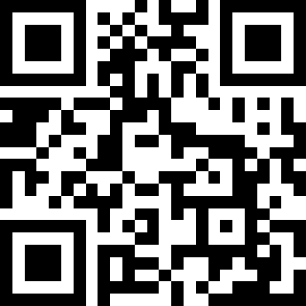
2. Exec Reports: Internal Committee Sign-ups
Internal Committee Assignments are going out!
For CGPSA, we are still looking for at least:
1 Senator from College of Architecture and Urban Studies (CAUS)
It is a requirement that all senators participate in at least one external or internal committee/commission.
Please fill out the interest forms if you have not!
https://tinyurl.com/GPSS23Signup

Slide 12
2. Exec Reports: 5% Raise/Comprehensive Fees
Meeting with Amy Sebring moved to Friday at 8am
Should have the university’s last year of data for 5% increases early next week
They did not pull the last few years, but will

Slide 13
2. Exec Reports: Housing
Ad-hoc committee to sift through last year’s data and compare to university’s cost of living estimate
Working Group focused on:
Affordable housing
Reporting Mechanism for town of Blacksburg for tenants
If interested please contact Rachel and/or Yohan maizer@vt.edu and yohans21@vt.edu

Slide 14
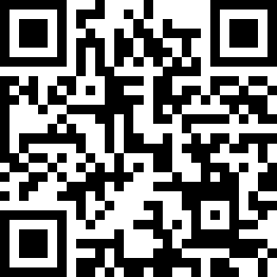
2. Exec Reports: Department Climate & Culture
Reminder to fill out the survey and share with your constituents.
https://tinyurl.com/GPSSClimateSuggestion
If you are interested in helping analyze the data, advertise, and/or write the report please contact Rachel maizer@vt.edu
Notes:
entomology, cs

Slide 15
2. Exec Reports: Director of Finance
GPSS Budget, Beginning of the year:
Budget Board Allotment: $24,438
Generated Funds: $71, 265.95
Spent so far: ~7,000
GSBB:
Total Budget: $100,000
Allocated: ~10,000

Slide 16
2. Commission/Committee Reports
It is a requirement that all senators participate in at least one external or internal committee/commission.
Please fill out the interest forms if you have not!
https://tinyurl.com/GPSS23Signup

Slide 17
2. Commission/Committee Reports
Open time for all reps to Commissions/Committees to give updates and have discussion.

Slide 18
3. Elections: Director of Advocacy
Elections will be held for Director of Advocacy.
If you are interested please fill out last year’s application and email it to our newly appointed Election Czar Caroline de Jager: cdejager@vt.edu by 9/14/2023

Slide 19
5. New Business: Commission/Committees
Need to vote to approve GSBB members, CGPSA members, and External Committee members (note that in some cases positions can be shifted based on availability, but we need to approve the member lists to give them to the university administration)
Parliamentarian: Ranald Adams
Link to Current Committee Assignments:
https://docs.google.com/spreadsheets/d/1RC9z7DDYLY0-57JOLbeVvwuSMHQGaqzVDtqKjHomcxw/edit?usp=sharing

Slide 20
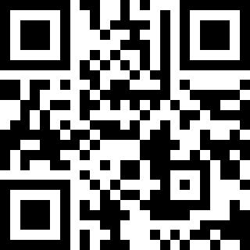
5. New Business: Commission/Committees
Vote now:
https://tinyurl.com/Vote9-7-23

Slide 21
5. New Business: Bylaws 1st Reading
A new addition section 3.4 was suggested in light of recent developments regarding the sharing of data (which previous E-board’s have done in the past with relevant entities)
https://docs.google.com/document/d/1o_6VlY8Fa68F9do05ayq8B8T5CS58I08B7dNq_GPNC8/edit?usp=sharing

Slide 22
5. New Business: VT GLU
Statement of support for the new Virginia Tech Graduate Labor Union (VT GLU)
Open for discussion: https://docs.google.com/document/d/1n0uWe4Xf8TFKPpgNL3ll9INsolWWeij0ucvyhfo65yo/edit?usp=sharing

Slide 23
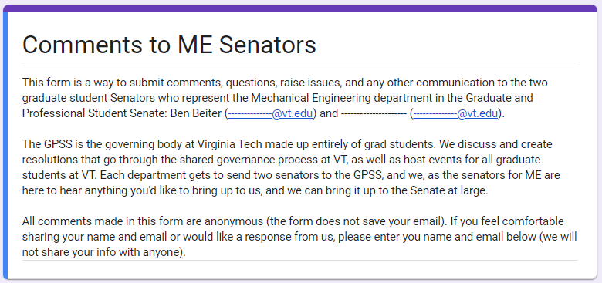
Closing Remarks: Communication
All Senators are expected to communicate with your constituents.
Send out Senate Brief to everyone
Anonymous Feedback Form
Notes:
Feedback about Senate meetings or resolutions

Slide 24
Conclusion
Senate Discord:
Motion to Adjourn!
Follow us on Instagram and Twitter:
@vtgpss
Public GPSS Discord for all grad students:
tinyurl.com/GPSS22GradDiscord

